Slide 1
Lecture 11
Tuesday, February 21, 2017
High Road Capitalism

Slide 2
A Economic Balance sheet for the United States at the beginning of the 21st Century

Slide 3
Average real weekly earnings of private production nonsupervisory workers,
1947-2011 (2011 dollars)

Slide 4
Change in family income by income group
1947-79 compared to 1979-2012

Slide 5
Trends in productivity and compensation, 1973-2011

Slide 6
Annual growth in productivity and compensation
during periods of economic expansion, 1975-2011

Slide 7
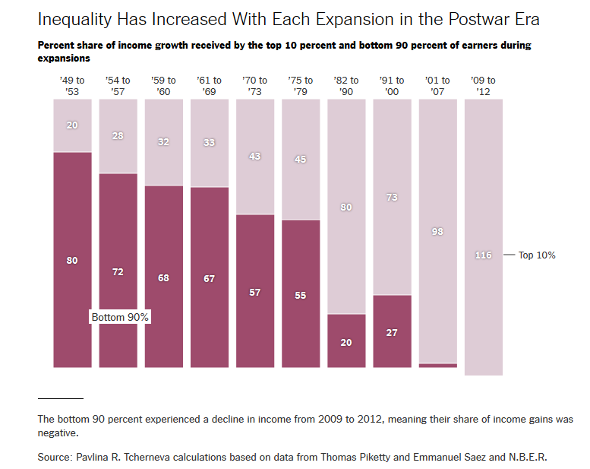

Slide 8
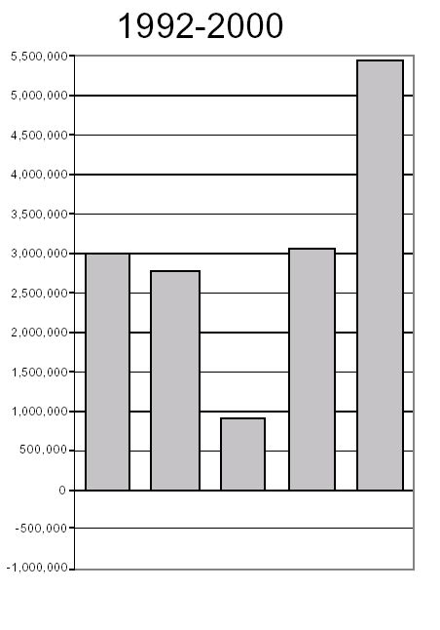
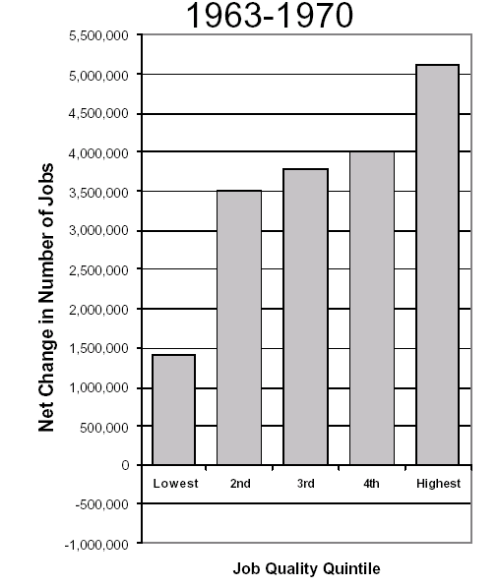
Patterns of Job Growth in the US, 1960s versus 1990s

Slide 10
U.S. Exports, Imports and trade balance: 1947-2012
Era of trade deficits

Slide 11
What should be done?
“Close off the low road, pave the high road, and help firms and workers move from the first to the second.”
Joel Rogers

Slide 12
High Road versus Low Road Capitalism
 | “Low Road” | “High Road”
Basis of firm competition
Nature of product market
Typical jobs
skills
training
Training process
Job autonomy
hierarchy
wages

Slide 13
High Road versus Low Road Capitalism
 | “Low Road” | “High Road”
Basis of firm competition | primarily price | primarily quality
Nature of product market
Typical jobs
skills
training
Training process
Job autonomy
hierarchy
wages

Slide 14
High Road versus Low Road Capitalism
 | “Low Road” | “High Road”
Basis of firm competition | primarily price | primarily quality
Nature of product market | mass goods, homogeneous products | specialized/customized goods
Typical jobs
skills
training
Training process
Job autonomy
hierarchy
wages

Slide 15
High Road versus Low Road Capitalism
 | “Low Road” | “High Road”
Basis of firm competition | primarily price | primarily quality
Nature of product market | mass goods, homogeneous products | specialized/customized goods
Typical jobs | very specialized | multi-task
skills
training
Training process
Job autonomy
hierarchy
wages

Slide 16
High Road versus Low Road Capitalism
 | “Low Road” | “High Road”
Basis of firm competition | primarily price | primarily quality
Nature of product market | mass goods, homogeneous products | specialized/customized goods
Typical jobs | very specialized | multi-task
skills | low skill: “trained gorilla” | high skill
training
Training process
Job autonomy
hierarchy
wages

Slide 17
High Road versus Low Road Capitalism
 | “Low Road” | “High Road”
Basis of firm competition | primarily price | primarily quality
Nature of product market | mass goods, homogeneous products | specialized/customized goods
Typical jobs | very specialized | multi-task
skills | low skill: “trained gorilla” | high skill
training | job specific & concrete skills | meta skills transferable across jobs
Training process | short job training provided by employers | life-time training and retraining provided by employers and public institutions
Job autonomy
hierarchy
wages

Slide 18
High Road versus Low Road Capitalism
 | “Low Road” | “High Road”
Basis of firm competition | primarily price | primarily quality
Nature of product market | mass goods, homogeneous products | specialized/customized goods
Typical jobs | very specialized | multi-task
skills | low skill: “trained gorilla” | high skill
training | job specific & concrete skills | meta skills transferable across jobs
Training process | short job training provided by employers | life-time training and retraining provided by employers and public institutions
Job autonomy | Low | high
hierarchy
wages

Slide 19
High Road versus Low Road Capitalism
 | “Low Road” | “High Road”
Basis of firm competition | primarily price | primarily quality
Nature of product market | mass goods, homogeneous products | specialized/customized goods
Typical jobs | very specialized | multi-task
skills | low skill: “trained gorilla” | high skill
training | job specific & concrete skills | meta skills transferable across jobs
Training process | short job training provided by employers | life-time training and retraining provided by employers and public institutions
Job autonomy | Low | high
hierarchy | rigid differentiation of managers and workers with many managerial layers | low differentiation of managers and workers with few layers
wages

Slide 20
High Road versus Low Road Capitalism
 | “Low Road” | “High Road”
Basis of firm competition | primarily price | primarily quality
Nature of product market | mass goods, homogeneous products | specialized/customized goods
Typical jobs | very specialized | multi-task
skills | low skill: “trained gorilla” | high skill
training | job specific & concrete skills | meta skills transferable across jobs
Training process | short job training provided by employers | life-time training and retraining provided by employers and public institutions
Job autonomy | Low | high
hierarchy | rigid differentiation of managers and workers with many managerial layers | low differentiation of managers and workers with few layers
wages | relatively low wages | relative high wages

Slide 21
Problems moving from the low road to the high road

Slide 22
The Relation of skill levels of workers to profits of firms
Profits
Low
High
Skill Level of Workers in a firm

Slide 23
Two ways to increase profits
deskilling
Skill enhancement
Profits
Low
High
Skill Level of Workers in a firm

Slide 24
THE TRANSITION TROUGH TRAP
High road
Ability to compete in international competition
Low Road
Transition trough from low road to high road
Time

Slide 25
 |  |  | You provide training
 |  |  | YES | NO
All other firms provide training |  | YES | $20,000 A | $30,000 B
 |  | NO | -$10,000 C | $0 D
The Training Deficit Trap:
a free riding problem (from lecture 4 & 5)
Training costs = $10,000
Extra Gross Profits with trained workers = $30,000
Net extra profits if you provide training and keep workers = $20,000
Net extra profits if you provide training and workers leave = -$10,000

Slide 26
The anti-union trap:
The relationship of union strength to competitiveness of firms
Competitiveness
Low
High
Strength of worker organization and participation

Slide 27
The anti-union trap:
The relationship of union strength to competitiveness of firms
Competitiveness
The USA today
Low
High
Strength of worker organization and participation

Slide 28
The anti-union trap:
The relationship of union strength to competitiveness of firms
continuing the low road
Competitiveness
Moving toward the high road
The USA today
Low
High
Strength of worker organization and participation

Slide 29
Solutions
Close off the low road
High minimum wage
Labor law reform to facilitate rebuilding unions
2. Pave the high road
Transition trough trap: subsidize transition costs
Training deficit trap: extensive public involvement in training

Slide 30
Solutions
Close off the low road
High minimum wage
Labor law reform to facilitate rebuilding unions
2. Pave the high road
Transition trough trap: subsidize transition costs
Training deficit trap: extensive public involvement in training

Slide 31
Solutions
Close off the low road
High minimum wage
Labor law reform to facilitate rebuilding unions
2. Pave the high road
Transition trough trap: subsidize transition costs
Training deficit trap: extensive public involvement in training

Slide 32
Solutions
Close off the low road
High minimum wage
Labor law reform to facilitate rebuilding unions
2. Pave the high road
Transition trough trap: subsidize transition costs
Training deficit trap: extensive public involvement in training

Slide 33
Solutions
Close off the low road
High minimum wage
Labor law reform to facilitate rebuilding unions
2. Pave the high road
Transition trough trap: subsidize transition costs
Training deficit trap: extensive public involvement in training

Slide 34
Solutions
Close off the low road
High minimum wage
Labor law reform to facilitate rebuilding unions
2. Pave the high road
Transition trough trap: subsidize transition costs
Training deficit trap: extensive public involvement in training

Slide 35
Solutions
Close off the low road
High minimum wage
Labor law reform to facilitate rebuilding unions
2. Pave the high road
Transition trough trap: subsidize transition costs
Training deficit trap: extensive public involvement in training

Slide 36
End of Lecture 10 The Financial Crisis of 2007-2009

Slide 37
The nature of the housing market
Mortgage loans
Risks and Foreclosures
Derivatives: Mortgage-backed securities
Speculative markets in housing & in derivatives

Slide 38
What happened?
Changes in the mortgage market fueled house price rise.
Key innovation was the derivatives market in Mortgage-backed securities
Result was rapid growth in sub-prime mortgages among other instruments
Investment banks got heavily into the speculative market
The speculation became increasingly leveraged (borrowing to invest)
When prices started declining, the whole structure unraveled, beginning with Lehman Brothers
Bailout needed to prevent total financial system collapse

Slide 39
What happened?
Changes in the mortgage market fueled house price rise.
Key innovation was the derivatives market in Mortgage-backed securities
Result was rapid growth in sub-prime mortgages among other instruments
Investment banks got heavily into the speculative market
The speculation became increasingly leveraged (borrowing to invest)
When prices started declining, the whole structure unraveled, beginning with Lehman Brothers
Bailout needed to prevent total financial system collapse

Slide 40
Housing price bubble

Slide 41
What happened?
Changes in the mortgage market fueled house price rise.
Key innovation was the derivatives market in Mortgage-backed securities
Result was rapid growth in sub-prime mortgages among other instruments
Investment banks got heavily into the speculative market
The speculation became increasingly leveraged (borrowing to invest)
When prices started declining, the whole structure unraveled, beginning with Lehman Brothers
Bailout needed to prevent total financial system collapse

Slide 42
What happened?
Changes in the mortgage market fueled house price rise.
Key innovation was the derivatives market in Mortgage-backed securities
Result was rapid growth in sub-prime mortgages among other instruments
Investment banks got heavily into the speculative market
The speculation became increasingly leveraged (borrowing to invest)
When prices started declining, the whole structure unraveled, beginning with Lehman Brothers
Bailout needed to prevent total financial system collapse

Slide 43
What happened?
Changes in the mortgage market fueled house price rise.
Key innovation was the derivatives market in Mortgage-backed securities
Result was rapid growth in sub-prime mortgages among other instruments
Investment banks got heavily into the speculative market
The speculation became increasingly leveraged (borrowing to invest)
When prices started declining, the whole structure unraveled, beginning with Lehman Brothers
Bailout needed to prevent total financial system collapse

Slide 44
What happened?
Changes in the mortgage market fueled house price rise.
Key innovation was the derivatives market in Mortgage-backed securities
Result was rapid growth in sub-prime mortgages among other instruments
Investment banks got heavily into the speculative market
The speculation became increasingly leveraged (borrowing to invest)
When prices started declining, the whole structure unraveled, beginning with Lehman Brothers
Bailout needed to prevent total financial system collapse

Slide 45
What happened?
Changes in the mortgage market fueled house price rise.
Key innovation was the derivatives market in Mortgage-backed securities
Result was rapid growth in sub-prime mortgages among other instruments
Investment banks got heavily into the speculative market
The speculation became increasingly leveraged (borrowing to invest)
When prices started declining, the whole structure unraveled, beginning with Lehman Brothers
Bailout needed to prevent total financial system collapse

Slide 46
What happened?
Changes in the mortgage market fueled house price rise.
Key innovation was the derivatives market in Mortgage-backed securities
Result was rapid growth in sub-prime mortgages among other instruments
Investment banks got heavily into the speculative market
The speculation became increasingly leveraged (borrowing to invest)
When prices started declining, the whole structure unraveled, beginning with Lehman Brothers
Bailout needed to prevent total financial system collapse

Slide 47
Magnitude of the crisis

Slide 48
2000-2011

Slide 53
What Can be done?
Strengthen and enforce Dodd-Frank regulations,
End Too-Big-To-Fail: break up the Monster Banks.
Build a more community-rooted financial system.

Slide 54
What Can be done?
Strengthen and enforce Dodd-Frank regulations.
End Too-Big-To-Fail: break up the Monster Banks.
Build a more community-rooted financial system.

Slide 55
What Can be done?
Strengthen and enforce Dodd-Frank regulations.
End Too-Big-To-Fail: break up the Monster Banks.
Build a more community-rooted financial system.

Slide 56
What Can be done?
Strengthen and enforce Dodd-Frank regulations.
End Too-Big-To-Fail: break up the Monster Banks.
Build a more community-rooted financial system.

